Slide 1
Research Integrity for new PhD students
Jonathan Grigg
Deputy Dean for Research Integrity
School of Medicine and Dentistry

Slide 2
Research Integrity
What is research integrity?
Plagiarism
Scientific misconduct
Reporting scientific misconduct
Ethical Review
Suboptimal research practices
Common and not so common scenarios

Slide 3
Building Blocks of Science
Honesty - Scientists depend upon the truthfulness of their colleagues; each of us builds our discoveries on the work of others; if that work is false, our constructions fall like a house of cards and we must start all over again. The great success of science in our time is based on honesty.
Community - scientists do virtually nothing alone; we exchange ideas in frenzies of excitement; we design and perform experiment together; we rely upon one another day in and day out; we take pleasure in discoveries, no matter who has made them; we give credit where it is due.
Commitment - We love the purposes of science, we love the practice of science, we love to teach the lore of science. These passions give us gratification. And they inspire us to do our best - sometimes even to exceed ourselves.
Courage - Most of the great discoveries in science come from bold acts of the imagination, intellectual daring of the highest order.
Excerpt from Ahearne (1999)

Slide 4
Integrity of Research - QM
Integrity
Academic staff, research staff, visiting academics and research students should be honest in respect of their own actions in research and in their responses to the actions of other researchers. This applies to all research work, including experimental design, generating and analysing data, applying for funding, publishing results, recognising any real or potential conflicts of interest and acknowledging the direct and indirect contribution of colleagues, collaborators and any others involved in the research.
Reference: Queen Mary Guidelines on Good Practice in Research.

Slide 5
QM’s definition of Scientific Misconduct
Piracy - the deliberate exploitation of ideas from others without proper acknowledgement;
Plagiarism - the copying or misappropriation of ideas (or their expression), text, software or data (or some combination thereof) without permission and/or due acknowledgement;
Mis-representation - deliberate attempt to represent falsely or unfairly the ideas or work of others, whether or not for personal gain or enhancement;
Fraud - deliberate deception (which may or may not include the invention or fabrication of data).
Reference: QM Guidelines on Good Practice in Research

Slide 6
Plagiarism
Presenting someone else’s work as one’s own irrespective of intention. Extensive quotations; close paraphrasing; copying from the work of another person, including another student or using the ideas of another person, without proper acknowledgement, also constitute plagiarism.
Reference: QM Academic Regulations, Part 2 – General Regulation, §2.79.
Avoid plagiarism – use referencing
A reference is used whenever your work contains someone else’s words or ideas. A reference will ensure that the reader of the assignment can identify and locate the source of the information.
If you quote directly from another person’s work you must use quotation marks around the entire quote and reference the quote.
If you paraphrase – put another person’s work into different words but with the same meaning – you must reference the work.
If you use another person’s ideas, findings or research (i.e. facts they have established) in your work you must reference the work.

Slide 7
Reporting Scientific Misconduct
Misconduct can:
  Seriously impact research - yours, a colleague’s, your group’s
  Injure reputations of scientists and their institutions
  Shake public confidence in the integrity of science
  Result in imposition of institutional/governmental counter-productive regulations
Reporting misconduct is:
  An ethical obligation
  Not easy
  If mishandled, can damage stakeholders
Note:
  There may be different explanations to what you perceive
  Reprisals sometimes occur
  If your allegation is judged malicious or reckless you may be charged with scientific misconduct.
Reference: QM Procedure for Investigating Allegations of Misconduct in Academic Research (2000), Gunsalus, C.K. (1998)

Slide 8
Food for Thought
“In the cases of scientific fraud that I have looked at, three motives, or risk factors have always been present. In all cases, the perpetrators:
  were under career pressure;
  knew, or thought they knew what the answer would turn out to be if they went to all the trouble of doing the work properly, and
  were working in a field where individual experiments are not expected to be precisely reproducible.”
Reference: Goodstein, David (1996)
If things go wrong, or you suspect misconduct amongst others
Talk with supervisor, or School Director of Graduate Studies, or School Research Administrator or your Deputy Dean.
Doing NOTHING is not an option!

Slide 9
Applying for Ethical Review

Slide 10
Under College Regulations, it is the responsibility of the supervisor to ensure any research which requires it is submitted for ethical review.
Conducting research which is subsequently deemed to have needed ethical review but was not considered is an offence.
Though your supervisor is ultimately responsible for ensuring your research is considered, it is YOUR research so think about this process yourself

Slide 11
So what research needs ethical review?
Any research involving human subjects, or human tissue, may need to go through ethical review.
2 routes for ethical review
If your research involves NHS patients, human tissues, staff, or premises you will need to go through NHS ethical review. This can take several months, so you need to think about the review process early:
Contact: research.submissions@bartshealth.nhs.uk
Web: http://www.bartshealth.nhs.uk/research/about-us/contact-us/
Phone: 020 7882 7250

Slide 12
If working in any other area, and your research involves human subjects, you should first check the College’s Fast Track Ethical review –
Contact: research.submissions@bartshealth.nhs.uk
Web: http://www.bartshealth.nhs.uk/research/about-us/contact-us/
Phone: 020 7882 7250
This is a simple web submission which will tell you within 15 days whether you need to complete a full ethics application

Slide 13
It will ask you to provide:
A 300-2000 word summary of your research
Answer 10 yes/no questions relating to your research – e.g. Are your research participants under 16, Will you be asking questions of a sensitive nature etc.
You can include brief comments alongside your answers
If you answer Yes to any of the questions you will be required to submit a full ethics application
Provide as clear a summary of your research as possible, in language accessible to non specialists.
You should make sure you include the following in your summary:
WHO your respondents are, and how you will contact them
HOW you will tell them about the research, ask them if they would like to participate, and how you will ensure their confidentially/anonymity
HOW you will work with them – e.g. a survey, interviews
WHAT you will be asking them
HOW you will store this data (securely)
HOW you will disseminate any research – e.g. where published?

Slide 14
If you are required to submit a full ethics application - don’t panic!
This is much more straight forward than you may fear.
You will need to complete a simply pro-forma, available here:
http://connect.qmul.ac.uk/research/ehics-of-research- committee/index.html
The pro forma will ask for much of the same information, but in a little more detail, as does the fast review, ie :
WHO your respondents are, and how you will contact them
HOW you will tell them about the research, ask them if they would like to participate, and how you will ensure their confidentially/anonymity
HOW you will work with them – e.g. a survey, interviews
WHAT you will be asking them
HOW you will store this data (securely)
HOW you will disseminate any research – e.g. where published?
The pro-forma includes a statement by your SUPERVISOR

Slide 15
Once submitted, the pro forma is passed for consideration to one of the College’s Ethical Review Panels
Each panel consists of a Chair, and 3 further academics – one from each Faculty to ensure multi-disciplinary expertise
The panel are sympathetic – each of them will at some stage have had to have completed ethical review and/or had students going through the process.
The panel has 3 main concerns:
Prevention of Harm – to research participants (including emotional harm), and researchers (are you e.g. interviewing in safe sites)
Informed Consent – do participants understand the research they are being asked if they would like to participate in? (include examples of your information sheet for participants, and a form for them to give consent) Do they understand how the research will be used (confidentiality/anonymity)
Management of Risk – will data be stored safely (electronically secure),does the research pose any reputational risk to the College (e.g. will it uncover/report illegal activities etc?)
WHO your respondents are, and how you will contact them
HOW you will tell them about the research, ask them if they would like to participate, and how you ensure their confidentially/anonymity
HOW you will work with them – e.g. a survey, interviews
WHAT you will be asking them
HOW you will store this data (securely)
HOW you will disseminate any research – e.g. where published?
The pro-forma includes a statement by your SUPERVISOR, and is submitted to Hazel Colville

Slide 16
Possible outcomes
Approval
Approval with advice
Conditional approval – subject to some minor revisions
Deferment/referral
Rejection
The panel are NOT primarily concerned with whether they think the research is well designed or worthwhile, though if they have major concerns with your methods they may offer some advice on how to improve them
The most common reasons for only conditional approval or referral are:
Materials to participants e.g. information sheets are unsatisfactory (too difficult to understand, not offering full information)
Data Issues (not securely stored)
Consent issues (not covering all eventualities e.g. do they also consent to the work being published? Them being identified?)
Safety concerns (meeting in public or safe spaces)

Slide 17
Process
The panel will invite you to attend the meeting to answer any questions they have about your application
Attend if you can – it is NOT a scary experience, and you may be able to answer any concerns they have there and then, avoiding the necessity for revisions: if there are revisions, it is a chance to ask exactly what is they want
Revisions are considered by the member of the panel who led in the discussion of your application – they can usually be approved by email
Allow 1-2 months from application to final approval – make sure you submit an application 1-2 months before you plan any data collection
Many Schools include successful completion of ethical review as part of the procedures for Year 1 Progression
Talk to your supervisor about ethical review – they will very likely have past successful applications by other students you can look at to make the whole thing easier
If you have any queries, contact Hazel Colville – she is extremely helpful!
Hazel Covill: h.covill@qmul.ac.uk
Phone: 020 7882 7915/5998

Slide 18
RI in practice
The end point - publication

Slide 19
Seven problematic areas
planning: protocol, statistical plan, ethics/consent, authorship and responsibilities decide early!
actual authorship = contribution = accountability
full + honest reporting
publish!
declaration of interest (conflict of interest)
responsibility after publication
Notes:
More than 200 authors on each of the human genome sequence papers published in Nature and Science in 2001

Slide 20
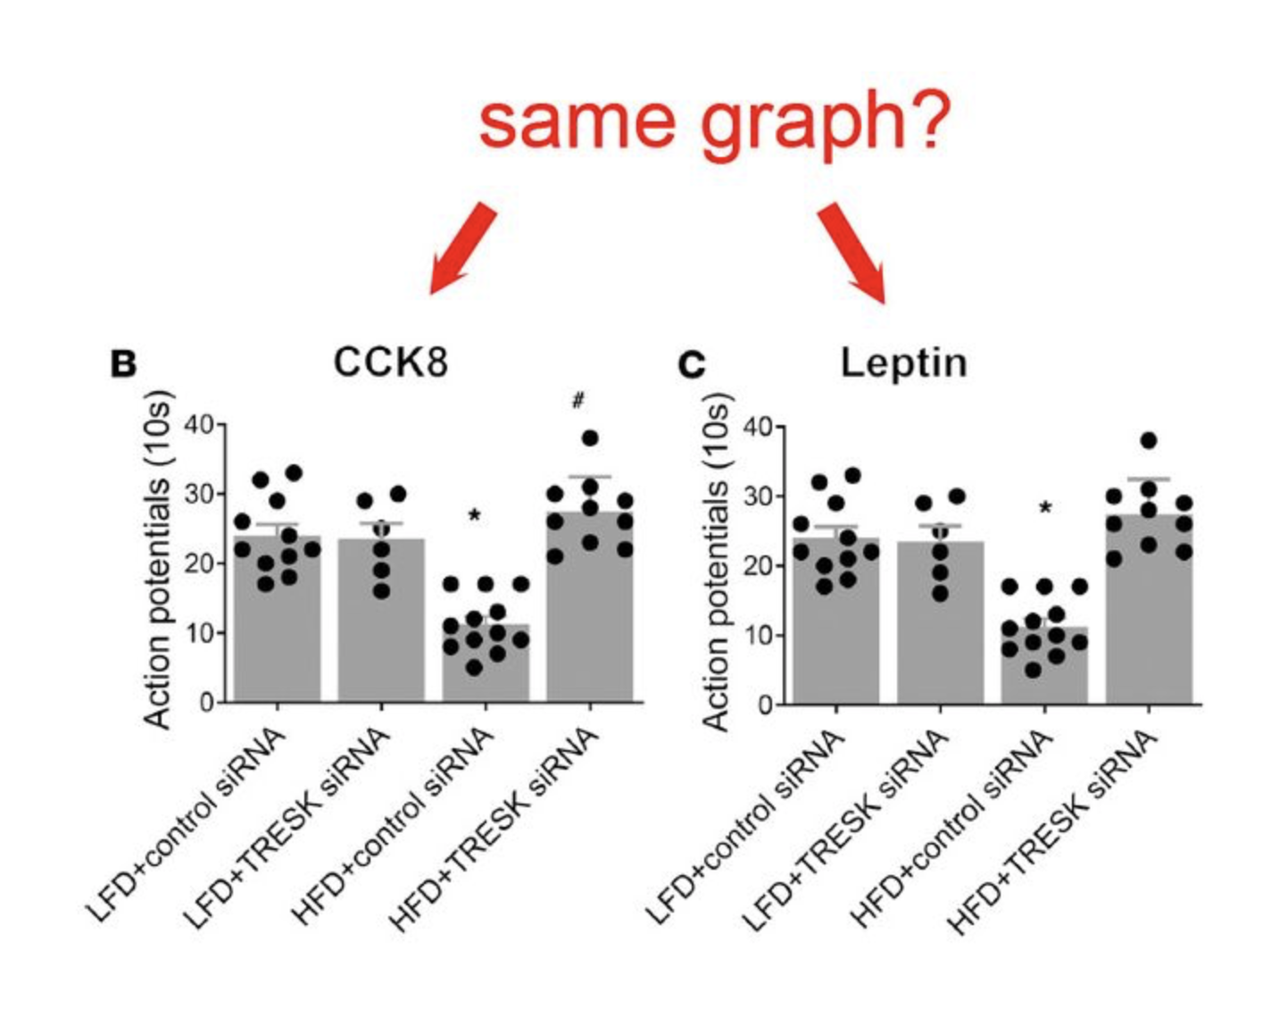
Pubpeer

Slide 21
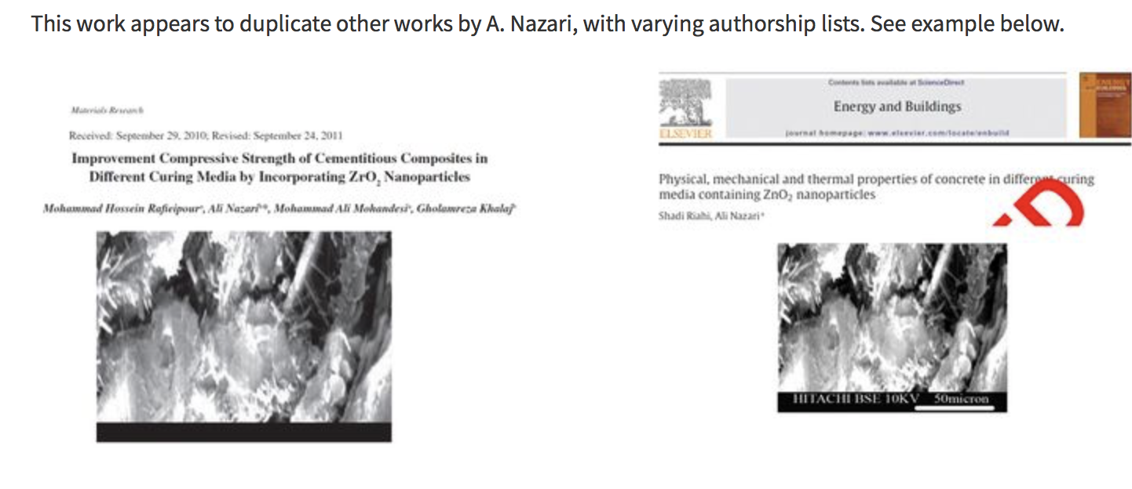

Slide 22
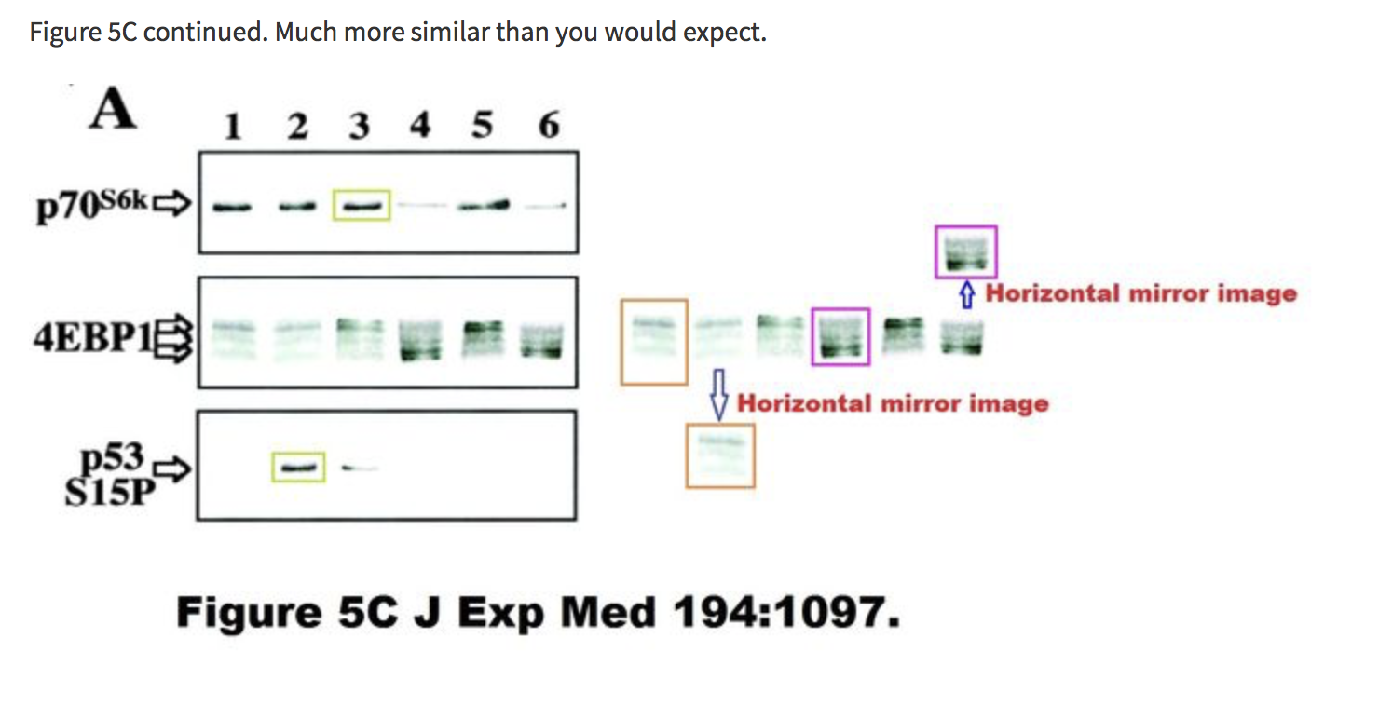

Slide 23
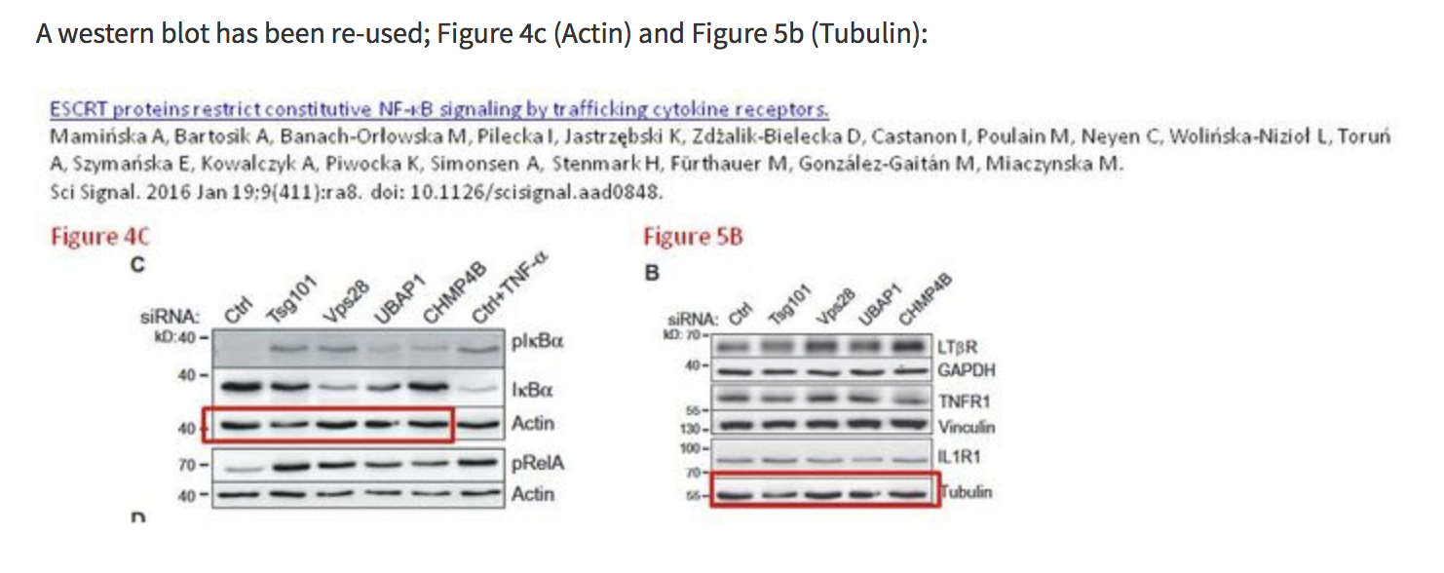

Slide 24
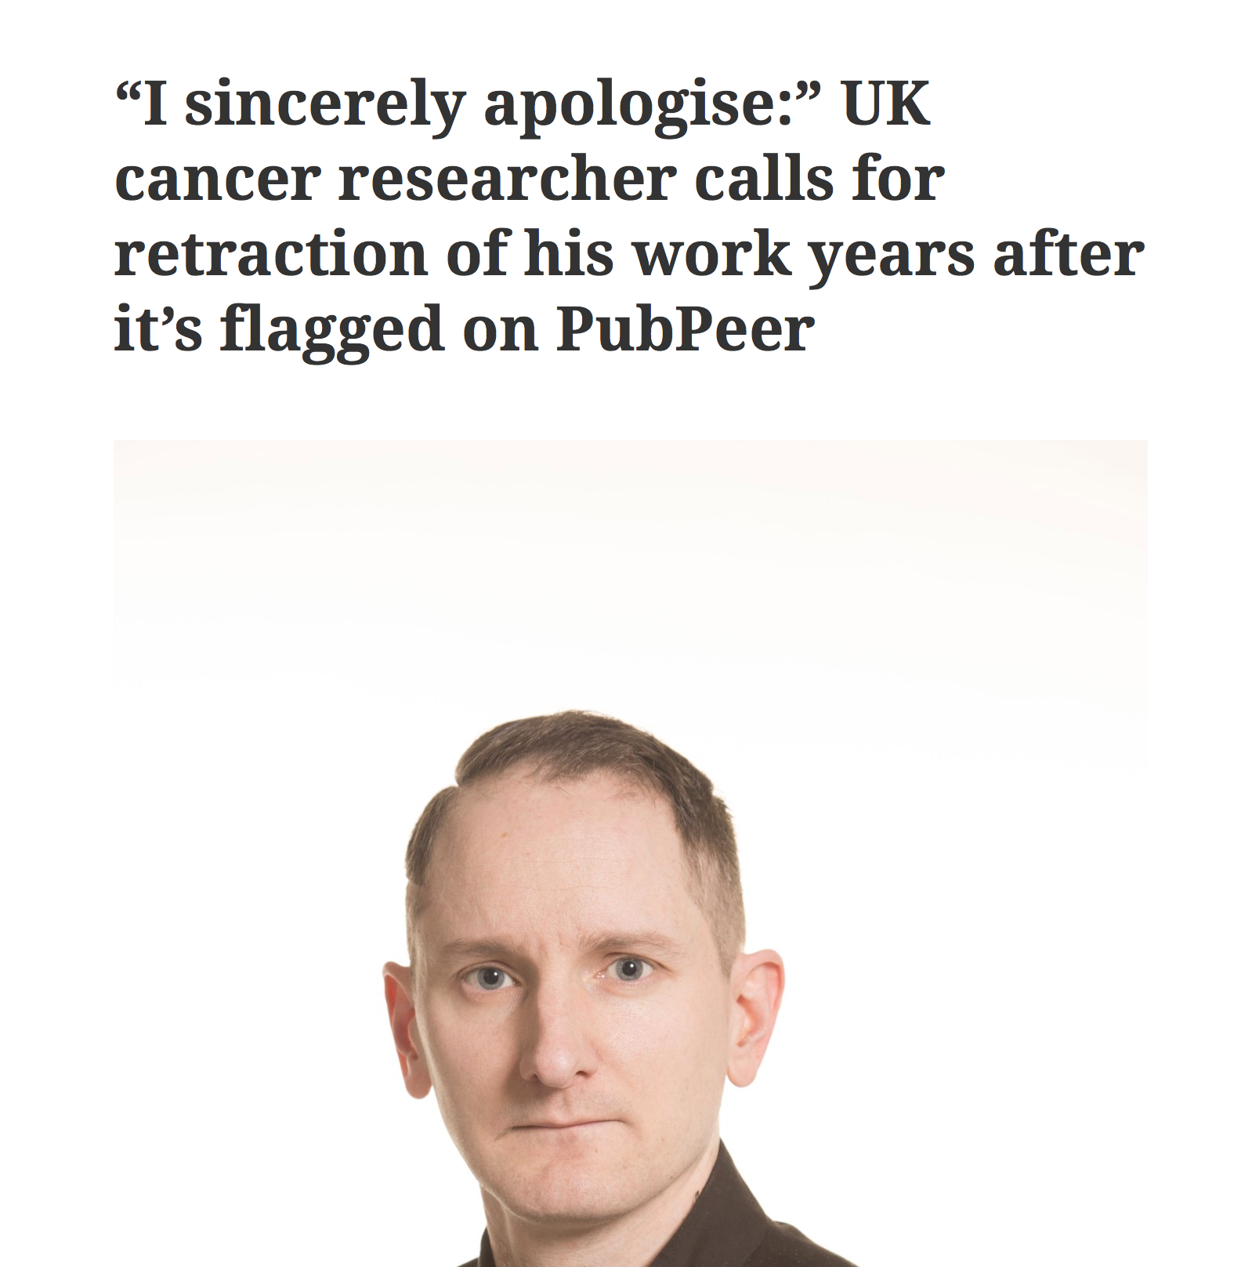

Slide 25
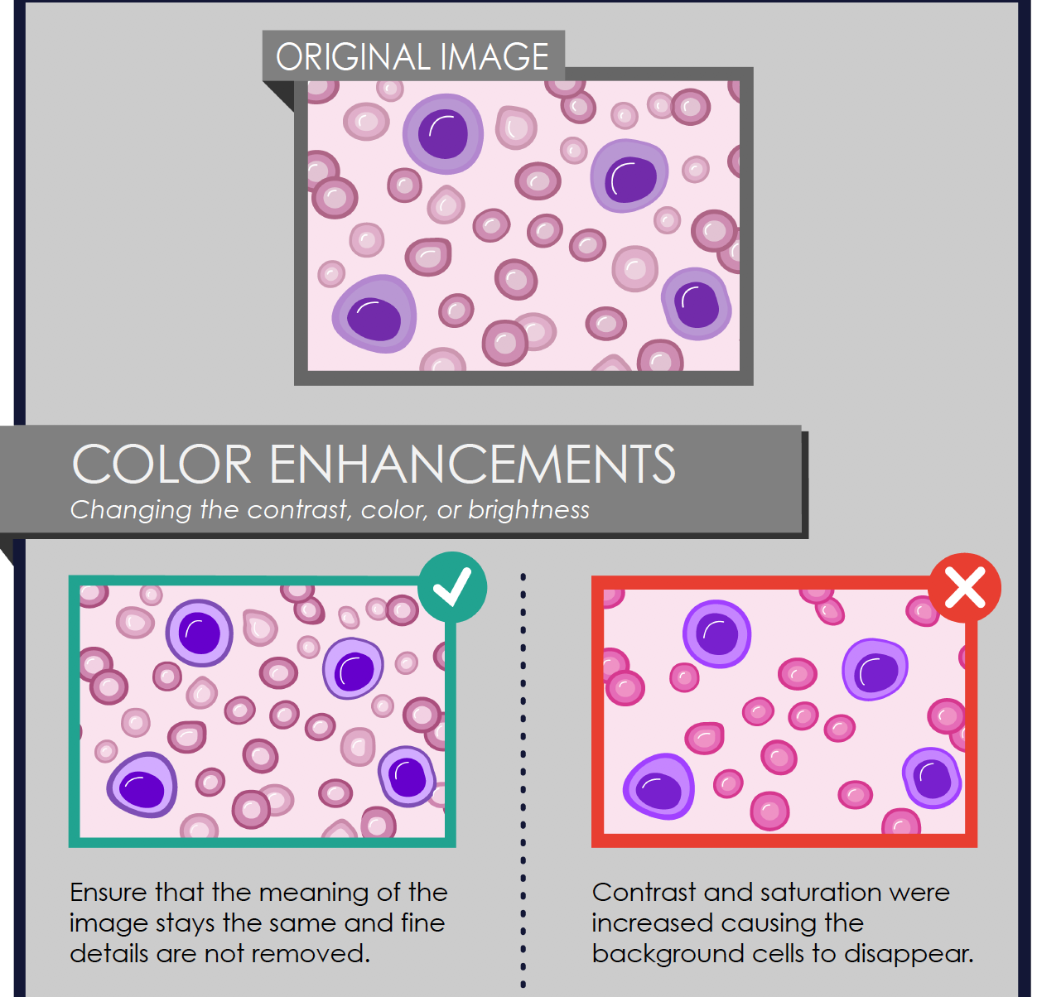
Images

Slide 26
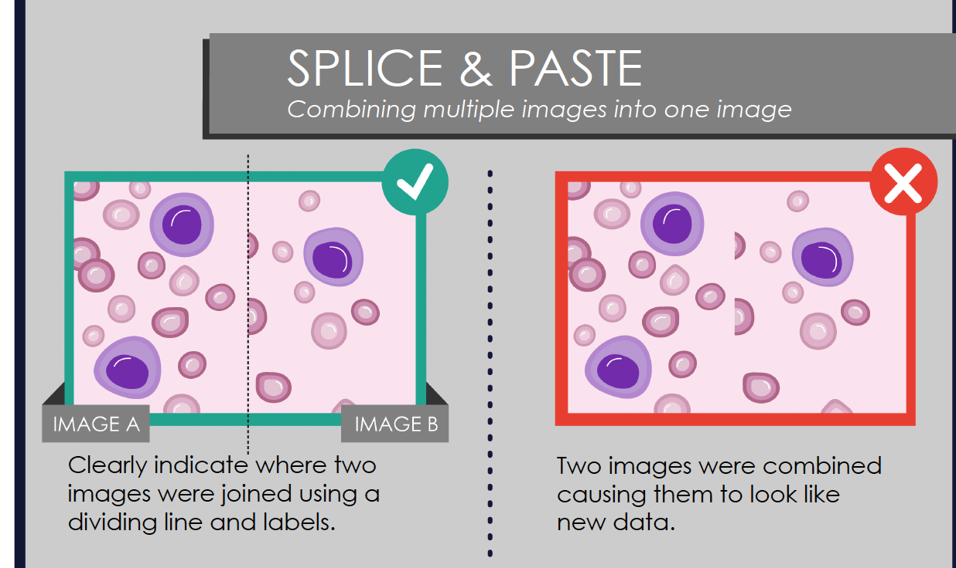

Slide 27
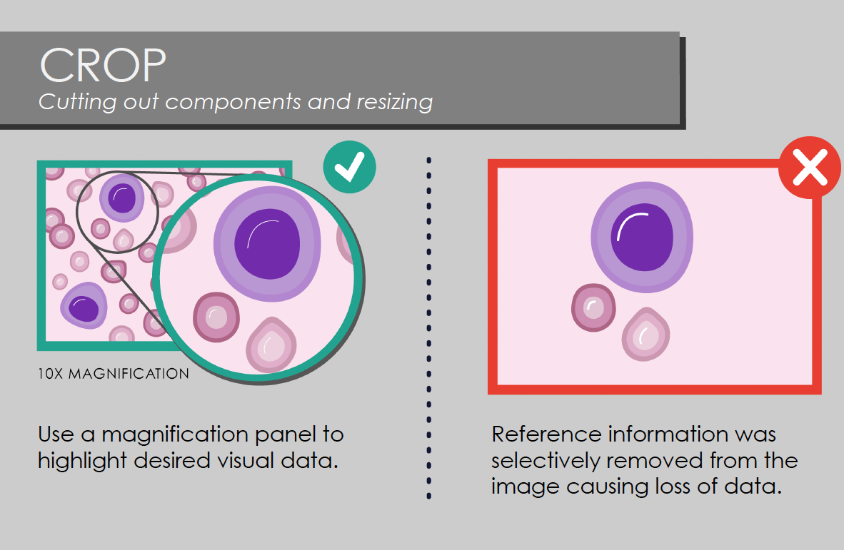

Slide 28
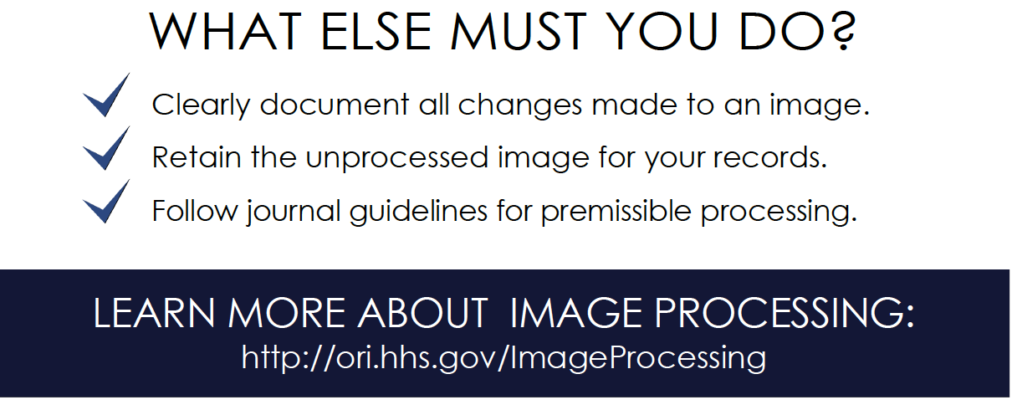

Slide 29
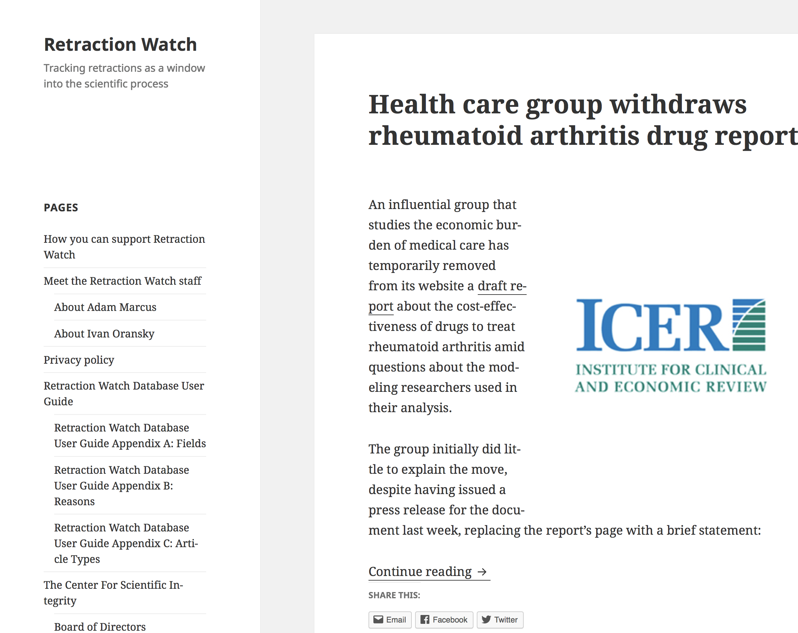
Retraction watch

Slide 30
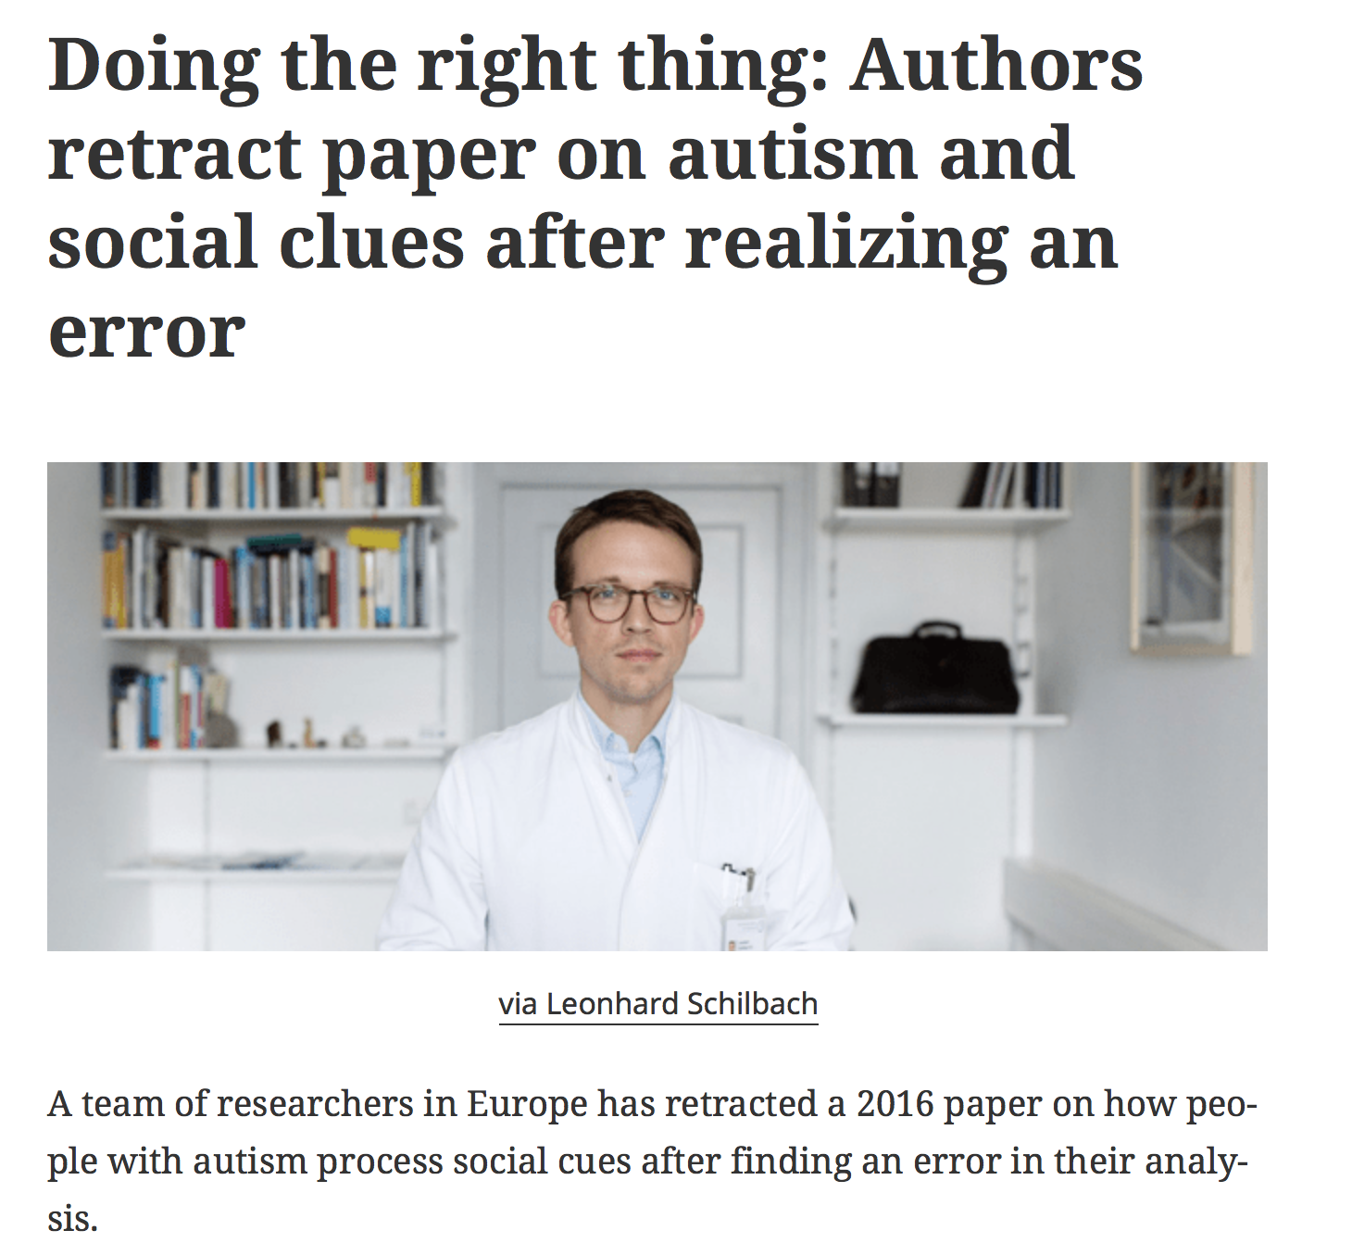

Slide 31
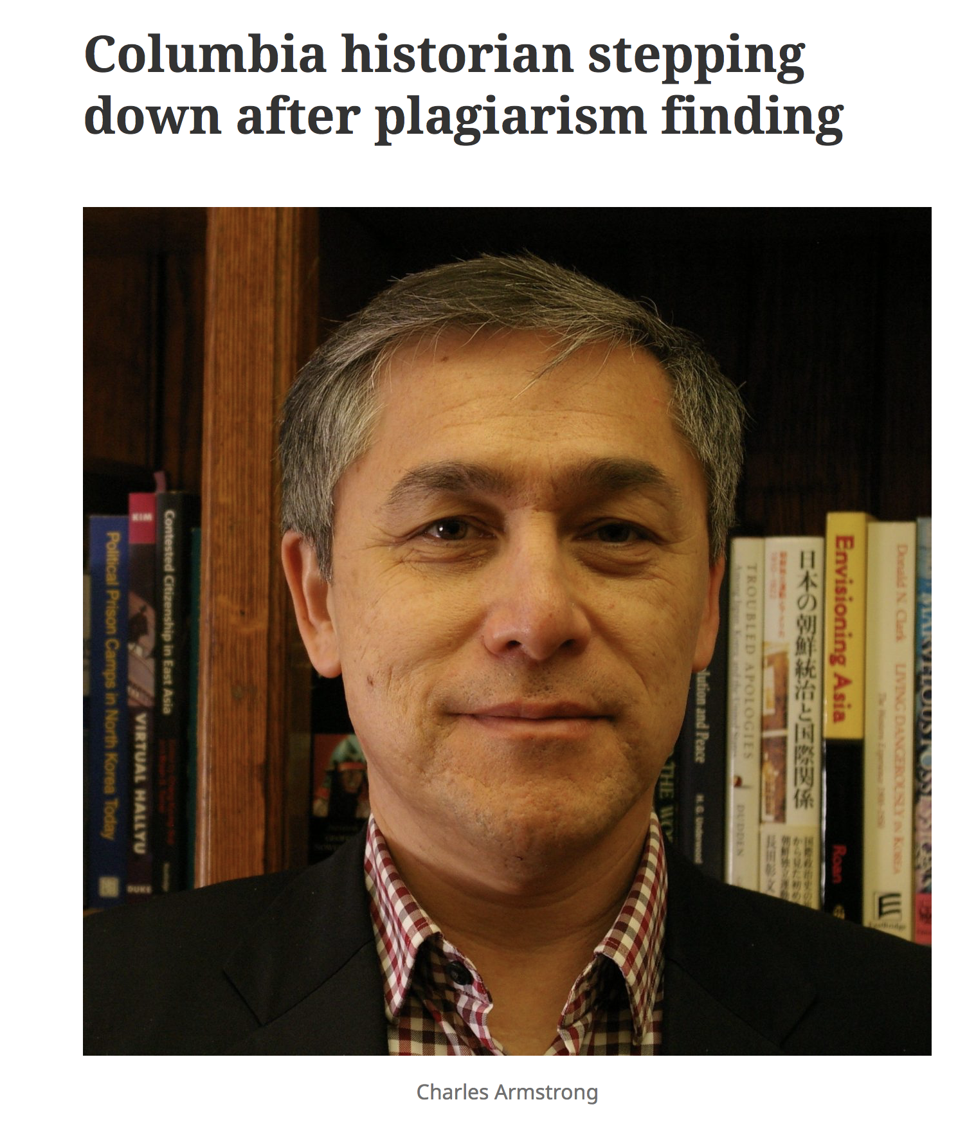

Slide 32
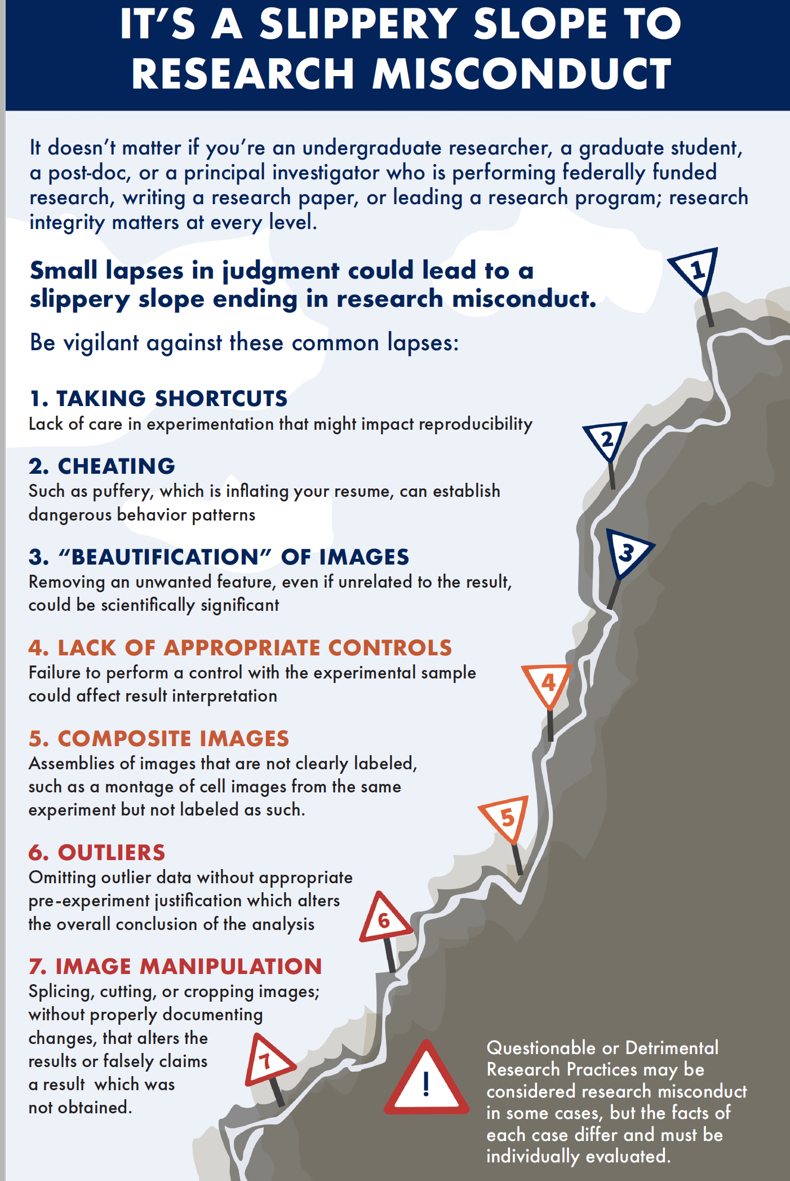

Slide 33
Scenarios
Ellie’s supervisor sent her a manuscript to referee for a journal. It was an interesting paper right in the area of Ellie’s research and described experiments that she hadn’t previously thought of doing. Ellie recommended that the manuscript was rejected and quickly set up the same experiments. Is this a problem?

Slide 34
Peter was presenting a poster at a conference. Several people came up to discuss the poster with him and one person made some really useful suggestions about what he might do as a follow-up study. Would it be research misconduct if Peter was to use this person’s ideas in his research?

Slide 35
Evan has nearly finished his PhD. He has been working in collaboration with another PhD student and they have produced quite a lot of joint data. Can this data be used in Evan’s PhD thesis?

Slide 36
Sally has a complete draft of her thesis and is almost ready to submit. But her written English is very poor. She asks her supervisor for help in correcting her writing or whether they know of any copy editing services they can recommend. Is this appropriate/acceptable?

Slide 37
Sally has a complete draft of her thesis and is almost ready to submit. But her written English is very poor. She asks her supervisor for help in correcting her writing or whether they know of any copy editing services they can recommend. Is this appropriate/acceptable?

Slide 38
Not allowed
change the text of the thesis so as to clarify and/or develop the ideas and arguments
reduce the length of the thesis so that it falls within the specified word limit
provide help with referencing
correct information within the thesis
change the ideas/arguments put forward in the thesis
translate the thesis into English (including using online translation tools).

Slide 39
Supervisors and examiners may suggest amendment, developments and clarifications as part of the supervision and examination process
but responsibility for the content of the final submitted thesis rests with the student.

Slide 40
resources
UKRIO
COPE

