Slide 2
Academic Promotions Round 2024-25
Faculty briefing session for applicants

Slide 3
Overarching Principles
Enabling – a framework for career development
Self-application – no requirement for prior approval or nomination
Evidence and alignment – applicants provide the evidence and impact of their contribution at the level they are applying for, in line with Academic Careers Framework and Queen Mary Values
Decision-making – responsibility for decisions on whether an applicant meets the criteria is with the promotion panels
Emphasis on quality and impact of contributions – promotion does not depend purely on metrics such as number of publications or grant income

Slide 4
Ensuring consistency and fairness
Consistent promotion panel composition across Schools/Institutes
Mandatory briefing sessions for all promotion panel members on promotion guidelines and criteria
Inclusion e-learning also required for all panel members
Briefing sessions offered to all academic staff who wish to apply
Schools/Institutes are sent lists of academic staff eligible for promotion
Explicit guidance on how to handle issues such as conflicts of interest, part-time colleagues, and personal circumstances
EDI statistics recorded, reported and reviewed by Faculty and University-level panels
HR specialists attend Faculty and University Panels to assist, guide and support

Slide 5
Eligibility
Lecturers, Senior Lecturers and Readers are eligible to apply for promotion if they meet the following criteria:
One year’s continuous employment on 31 December 2024;
Successfully completed the previous academic year’s annual appraisal/probationary review and have completed mandatory e-learning modules by the due dates
Guidelines and application form are at: http://hr.qmul.ac.uk/procedures/promotion/
Deadline for applications is Friday 31 January 2025

Slide 6
Promotion documentation for 2024/25
The Forms and Guidance for Applicants are largely unchanged for this round but please ensure you read through these fully before starting
Academic Careers Framework is also largely unchanged from when it was originally launched in 2021 – relevant points/changes are summarised below
Citizenship & Inclusion: continues to be a compulsory area of contribution
Education: also continues to be a compulsory area of contribution for all
Research: there continues to be emphasis in the criteria on the impact of the research output on society, the economy, industry, government or public policy
Scholarship: the criteria have been further reviewed and updated by the Queen Mary Academy to make the requirements clearer and more consistent
Enterprise & External Engagement: there continues to be an emphasis on research impact e.g. through knowledge exchange
Professional Practice: there continues to be an emphasis on the enhancement of Queen Mary’s reputation and impact in the relevant professional field.

Slide 7
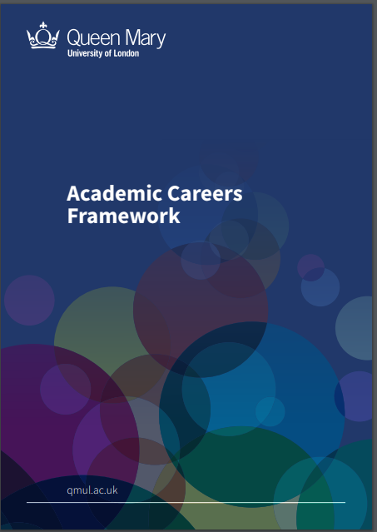
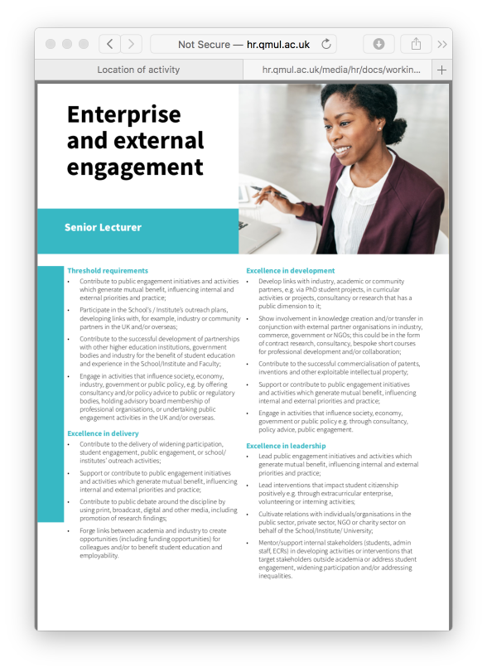
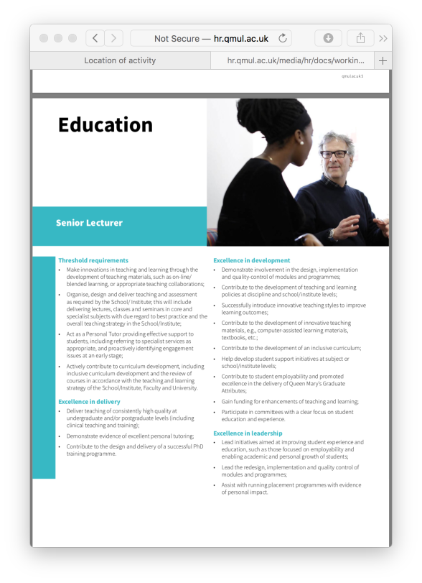
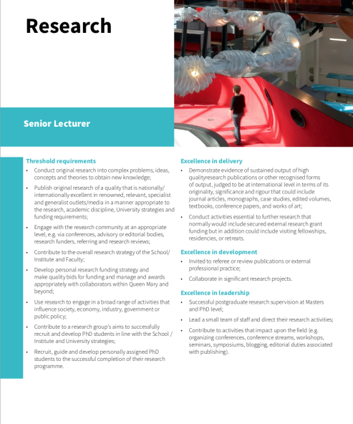
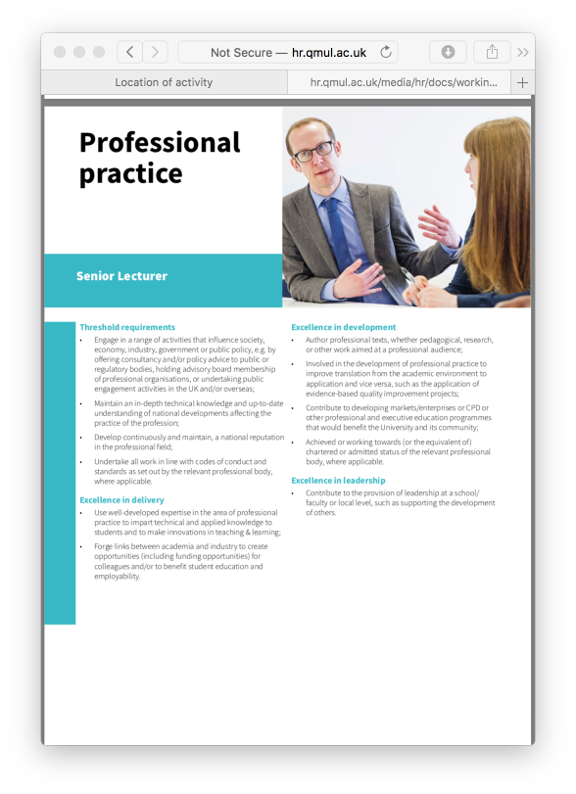
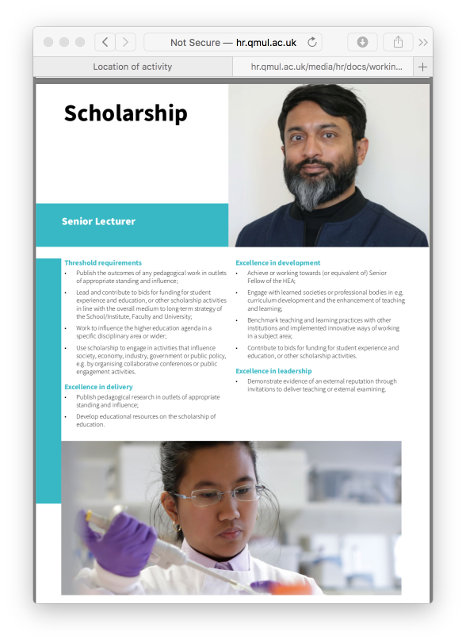
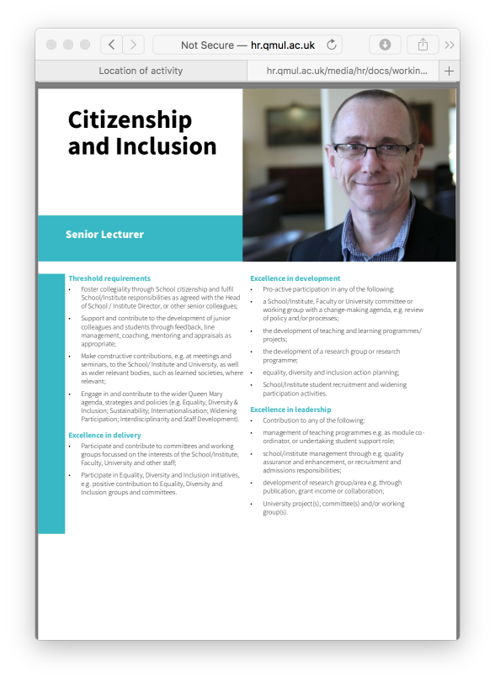
Academic Careers Framework is used in:
Discussing career trajectories/plans
Identifying development opportunities
Preparing for appraisals/annual reviews
Preparing academic promotion applications
HoS Assessments of promotion applications
Professorial Review – individual submissions
Demonstrating excellence and impact in development, delivery and leadership
Notes:
This Framework has been introduced for the first time this round and builds on the criteria that have been used in previous rounds. The aim is that this Framework will also to be used in preparing for appraisals/annual reviews, discussing career trajectories/plans, and identifying development opportunities.
Thresholds clarify the minimum requirements at each level.
The scope of activities and examples of excellence reflect the range of work at a large, multi-faculty university. They are not exhaustive.
In making decisions about which to apply, applicants should have regard to the context of their discipline(s).
Context of national or international collaboration important. There is no assumption that international collaboration is inherently more significant than one undertaken with national partners.

Slide 8
Demonstrating excellence and impact in your promotion application.
Show evidence of your excellence and impact in development, delivery and leadership in a minimum of 3 areas:
Citizenship & Inclusion
Education
Research
Scholarship
Enterprise & External Engagement
Professional Practice

Slide 9
Getting Started
Prepare early: Discuss your readiness for promotion with your Head of School, Academic Lead for Staff Development, or mentor; listen carefully to their feedback and advice
Review the documentation: The Promotion Guidelines, the Academic Careers Framework and the Application Form
Consider your role: T&R, T&S or T&PP
Make a list: Write down everything you think may be relevant; discuss with a colleague for ideas; use recent probation/appraisal documentation; sift the most compelling points which best demonstrate your contribution and impact

Slide 10
Building a case
Focus on evidence: for example, leadership roles you have undertaken, student feedback on your teaching, publications, grant applications and funding
Align to the Framework: identify which Areas of contribution your evidence is aligned to; ensure you can demonstrate excellence and impact in delivery, development and leadership (using the examples/criteria shown in the Academic Careers Framework)
Follow the guidelines: Read them carefully and ensure you complete all sections of the application form. Gaps in information, CVs in an incorrect format, or not providing evidence in sufficient Areas of contribution would result in your application being rejected.

Slide 11
Completing the Application form:
Hints and tips
Contractual designation: Select your current pathway; it’s not possible to change pathways via the academic promotions process.
Description of contribution: Three strong narratives present better than six vague ones; be concise and back up statements with evidence; do not exceed an average of 500 words per narrative.

Slide 12
Completing the Application form:
Hints and tips
Teaching accreditation: It is important to demonstrate that you have achieved a teaching accreditation.
Applicant CV: Make sure it is submitted in the format required.

Slide 13
Personal Circumstances
If you have any personal circumstances to be taken into account please declare it on the Personal Circumstances Statement and submit this to Human Resources at the time that you make your application to your Head of School/Institute Director.
Any information declared will remain confidential and only be seen and considered by a Personal Circumstances Panel, chaired by a Vice-Principal and including an HR representative and 2 senior members of academic staff (ex-Heads of School).
The Personal Circumstances Panel will assess the impact on your normal work activities as a result of the circumstances involved. A summary of the impact will be provided to the Promotion Panel by Human Resources. No details of the specific personal circumstances will be provided to the Promotion Panel.
The Promotion Panel will take the impact into consideration when deciding the effect this may have had on your contribution, with the aim of calibrating the usual expectations of what should have been achieved during a specific period. The standards and quality of contribution expected for promotion will still need to be present.

Slide 14
…and finally…
If you are not promoted in this round, don’t panic and don’t give up!
Listen carefully to the feedback; identify the gaps in your experience; consider how you can address these.
Speak to your line manager; actively seek opportunities to contribute at a higher level.
If you respond to the feedback and you can demonstrate additional contributions, you can reapply next year.

