Slide 1
Academic Promotions Round 2024
Briefing session for panel members
Tim Hubbard, Head of Reward and Benefits

Slide 2
Purpose and Agenda
Purpose
Agenda
Provide a run through of the academic promotion process and documentation
Overview of the promotions process, context and documentation
Clarify changes made for the 2024 promotion round
The Academic Careers Framework and application forms/guidance
Ensure a consistent approach across all 3 Faculties and all Schools/Institutes
The School/Institute Promotion Group and documentation
Notes:
SET has decided that all those involved in decision-making panels for academic promotion should receive training. The purpose of this training is to provide an overview of the academic promotion process and explain the changes that have been made for the 2024 promotion round. In providing training this will ensure a consistent approach across all 3 Faculties and all Schools and Institutes.

Slide 3
The Promotions Process at QM
Enabling – a framework for career development
Self-application – there is no requirement for prior approval or nomination
Evidence and alignment – applicants provide evidence of their contribution at the level they are applying for, in line with the Academic Careers Framework and Queen Mary Values
Decision-making – responsibility for decisions on whether an applicant meets the criteria is delegated to promotion panels
Emphasis on quality and impact of contribution, not quantity
Use of appropriate metrics to measure quality/impact
Notes:
Emphasis is on evidence of alignment to the standards set out in the Academic Careers Framework.
Consider a broad range of metrics, with the emphasis on qualitative/measurable evidence, but not purely quantitative such as amount of grant income or citation numbers. Focus on the quality and impact of contribution.
How would you consider student evaluation?

Slide 4

Promotions in context
Workload allocation
Appropriate metrics and “norms”
Appraisal
Manager’s feedback
Training and development needs
Self-assessment and reflection on achievements and trajectory
Guidance and forms available to all
Notes:
Consider each individual applicant’s workload allocation, overall FTE and personal circumstances in calibrating the quantity of output expected.
Metrics therefore to be qualitative rather than purely quantitative, but still evidence-based. Establish appropriate norms up front – ensure these are calibrated across the Faculty as appropriate.
Applicants should have had plenty of opportunities for feedback and development, via appraisals, 1:1s etc.
The promotion application is their opportunity to put forward their own ‘story’ regarding their achievements and career trajectory.

Slide 5
Ensuring consistency and fairness
  Consistent promotion panel composition across all Schools/Institutes
  Mandatory briefing sessions for all promotion panel members on the promotion guidelines and criteria; inclusion e-learning also required
  Briefing sessions offered to all academic staff who wish to apply
  Schools sent lists of all academic staff eligible for promotion
  Explicit guidance on how to handle issues such as conflicts of interest, and personal circumstances
  EDI statistics recorded, reported and reviewed by Faculty and University-level panels
  HR specialists attend Faculty and University Panels to assist, guide and support
Notes:
There are a number of ways that we aim to get a consistency across all Schools, Institutes and Faculties.

Slide 6
Eligibility
Lecturers, Senior Lecturers and Readers are eligible to apply for promotion if they meet the following criteria:
One year’s continuous employment on 31 December 2023;
Successfully completed the previous academic year’s annual appraisal/probationary review.
Guidelines and application form are at: http://hr.qmul.ac.uk/procedures/promotion/
Deadline for applications - Tuesday 31 January 2024

Slide 7
Promotion documentation for 2024
The Academic Careers Framework, Forms and Guidance for Applicants are largely unchanged for this round – relevant points/changes summarised below…
Education: this is a compulsory area of contribution for all applicants – note the importance of educational impact and link to student experience and KPIs
Citizenship & Inclusion: this is a compulsory area of contribution – note the importance of demonstrating the Values and role-modelling leadership behaviour
Research: the emphasis is on the quality and impact of the research output on society, the economy, industry, government or public policy
Scholarship: the criteria have recently been reviewed and updated by Queen Mary Academy to make the requirements clearer and more consistent
Professional Practice: there is an emphasis on external influence, impact and the enhancement of Queen Mary’s reputation in the relevant professional field
Enterprise & External Engagement: there is an emphasis on collaboration, initiatives and impact e.g. knowledge exchange
Notes:
Education – VP, Stephanie Marshall, is keen that there is a focus on educational impact and link to student experience and institutional KPIs
Citizenship & Inclusion is a compulsory area of contribution – note the importance of demonstrating the Values and role-modelling leadership
Research: the emphasis is on the quality and impact of the research output
Scholarship: the criteria have recently been reviewed and updated by Queen Mary Academy
Professional Practice: there is an emphasis on external influence, impact and the enhancement of Queen Mary’s reputation
Enterprise & External Engagement: there is an emphasis on collaboration, initiatives and impact

Slide 8

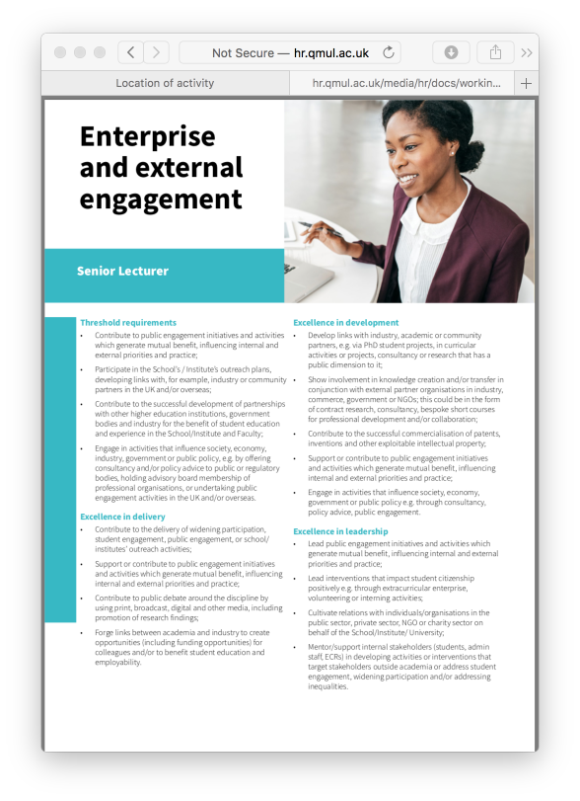
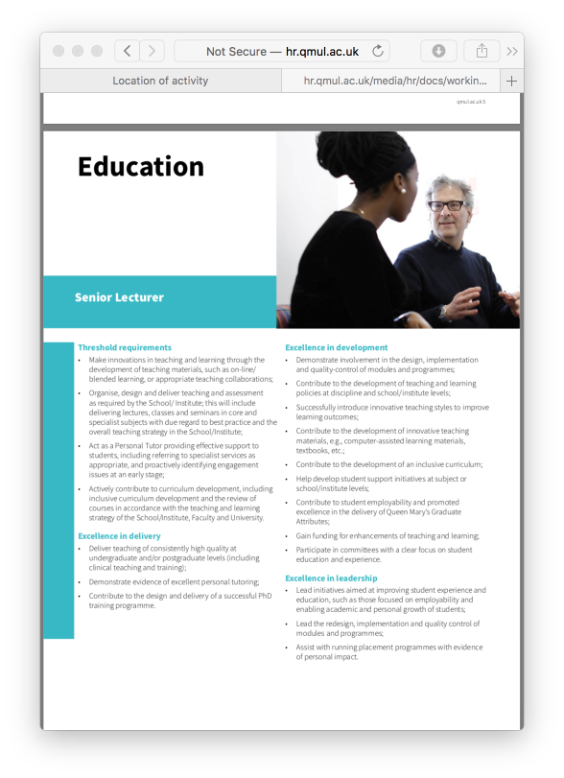
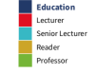
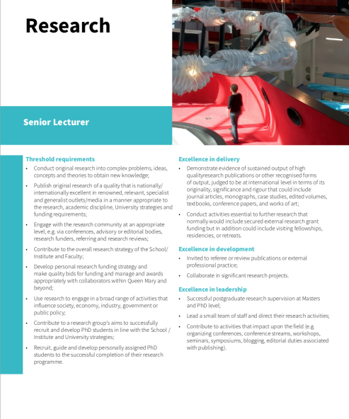
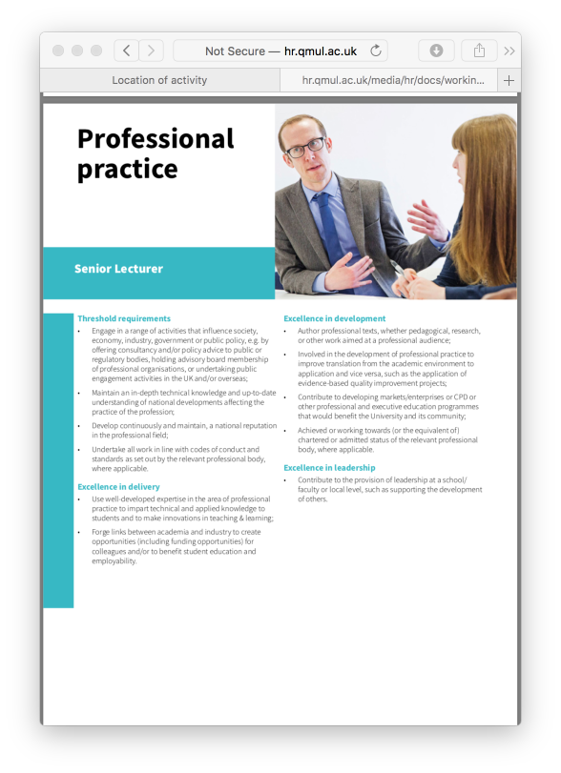
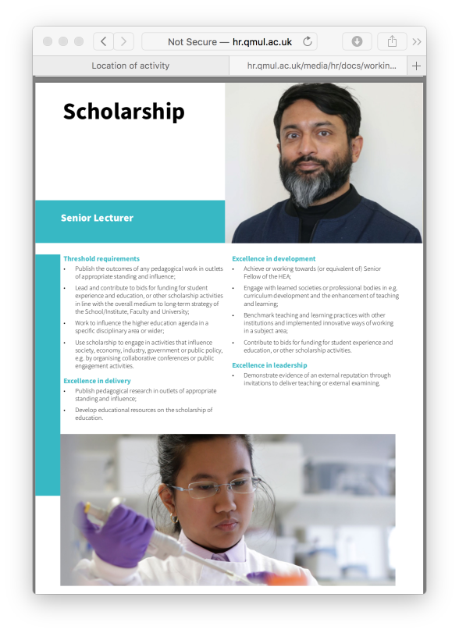
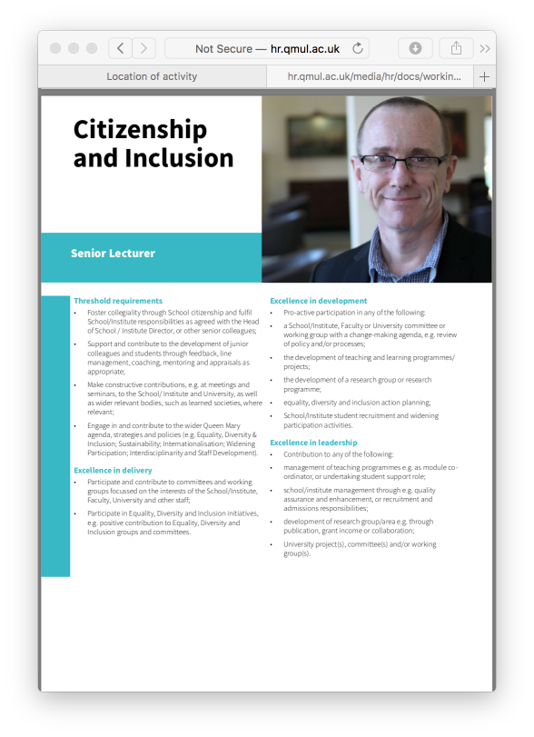
Academic Careers Framework is used in:
Discussing career trajectories/plans
Identifying development opportunities
Preparing for appraisals/annual reviews
Preparing academic promotion applications
Assessments of promotion applications
Professorial Review – individual submissions
Demonstrating excellence in development, delivery and leadership

Slide 9

Evidence of impact and excellence in development, delivery and leadership in a minimum of 3 areas:
Education*
Citizenship & Inclusion*
Research**
Scholarship**
Professional Practice**
Enterprise & External Engagement
* Compulsory areas of contribution
** Must be included according to career path

Slide 10

Applicant briefings
Applicant briefing session included:
Building a case for promotion
Tips in preparing a case
Completing the application form
Personal circumstances
Next 6 slides cover these aspects

Slide 11
Getting Started
Prepare early: Discuss your readiness for promotion with your Head of School, Academic Lead for Staff Development, or mentor; listen carefully to their feedback and advice
Review the documentation: The Promotion Guidelines, the Academic Careers Framework and the Application Form
Consider your role: T&R, T&S or T&PP
Make a list: Write down everything you think may be relevant; discuss with a colleague for ideas; use recent probation/appraisal documentation; sift the most compelling points which best demonstrate your contribution and impact

Slide 12
Building a case
Focus on evidence: for example, leadership roles you have undertaken, student feedback on your teaching, publications, grant applications and funding
Align to the Framework: identify which Areas of contribution your evidence is aligned to; ensure you can demonstrate excellence in delivery, development and leadership (using the examples/criteria shown in the Academic Careers Framework)
Follow the guidelines: Read them carefully and ensure you complete all sections of the application form. Gaps in information, CVs in an incorrect format, or not providing evidence in sufficient Areas of contribution would result in your application being rejected.

Slide 13
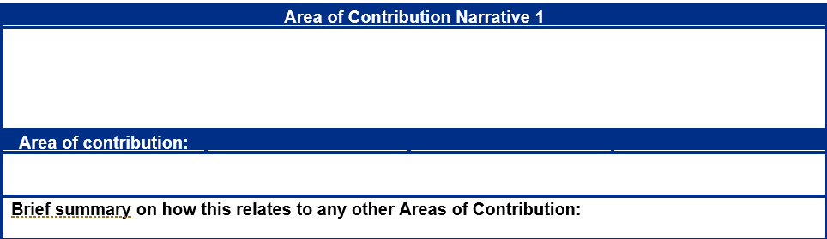
Completing the Application form:
Hints and tips
Contractual designation: Select your current pathway; it’s not possible to change pathways via the academic promotions process.
Description of contribution: Three strong narratives present better than six vague ones; be concise and back up statements with evidence; do not exceed an average of 500 words per narrative.

Slide 14
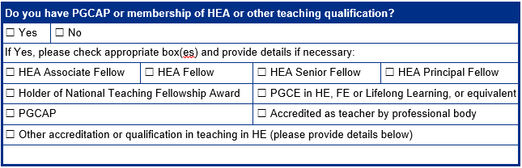
Completing the Application form:
Hints and tips
Teaching accreditation: It is important to demonstrate a teaching accreditation, or evidence of working towards it.
Applicant CV: Make sure it is submitted in the format required.
Notes:
Accreditation at least equivalent to Higher Education Academy Fellow, either achieved at the time of the promotion application submission, or evidence of progress towards achieving this within an agreed timeframe has been clearly set out in the promotion application.
Application for a professorial appointment is strengthened by the equivalent of Higher Education Academy Senior Fellow as a minimum. If the promotion is based on Education and Scholarship, then the expectation is Higher Education Academy Principal Fellow.

Slide 15
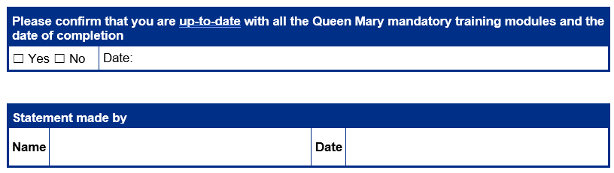
Completing the Application form:
Hints and tips
Mandatory training: It is important that you have completed the following mandatory training as a minimum:
Introducing Inclusion
Safeguarding Essentials
A new box has been added before the final application sign-off.

Slide 16
Personal Circumstances
Any personal circumstances to be taken into account may be declared in a Personal Circumstances Statement and submitted to HR when the application is made to the Head of School/Institute Director.
Any information declared remains confidential and is only seen and considered by the Personal Circumstances Panel, chaired by a Vice-Principal and including an HR representative and 2 senior members of academic staff (ex-Heads of School).
Personal Circumstances Panel assesses the impact on work of the circumstances. A summary of the impact is provided to Promotion Panels by HR. No details of the specific personal circumstances are provided to the Panels.
The Promotion Panels will take the impact into consideration when assessing the applicant’s contribution.
The expectation is that Panels calibrate the usual expectations of what should have been achieved during the period affected by the circumstances. The standards and quality of contribution expected for promotion will still need to be present.

Slide 17
Panels and Roles
School/Institute Promotion Group – chaired by Head/Director
  Makes recommendations to faculty
  Applicants receive feedback
  Optional: Applicant response
Faculty Promotion Panel – chaired by Faculty VP
  Review the School/Institute panel process and summary outcomes (e.g. EDI stats)
  Considers all cases (whether supported or not)
  Primary decision-making body
University Academic Promotions Group – chaired by Principal
  Overview of process; EDI and other statistics
  Receive any additional information (e.g. references for Professor)
  Ratification of Faculty Panel decisions; discuss by exception as needed

Slide 18
School/Institute Promotion Group
Chaired by the Head of School/Institute Director and include:
  The Deputy Head/Institute Director (or equivalents: no more than three individuals)
  An appropriate number of senior staff in the School/Institute proportionate to its size and management structure (typically including the Lead for Academic Development or the Academic Lead for Education and the School/Institute Manager or equivalents)
Head of School/Institute Director should ensure, as best as possible, that the panel is appropriately representative and inclusive
This panel will need to meet no earlier than 1 March and no later than 22 March
Deadline is 10 April for Heads to submit all completed applications to HR
At this meeting the Chair will need to complete the Group Meeting pro forma

Slide 19
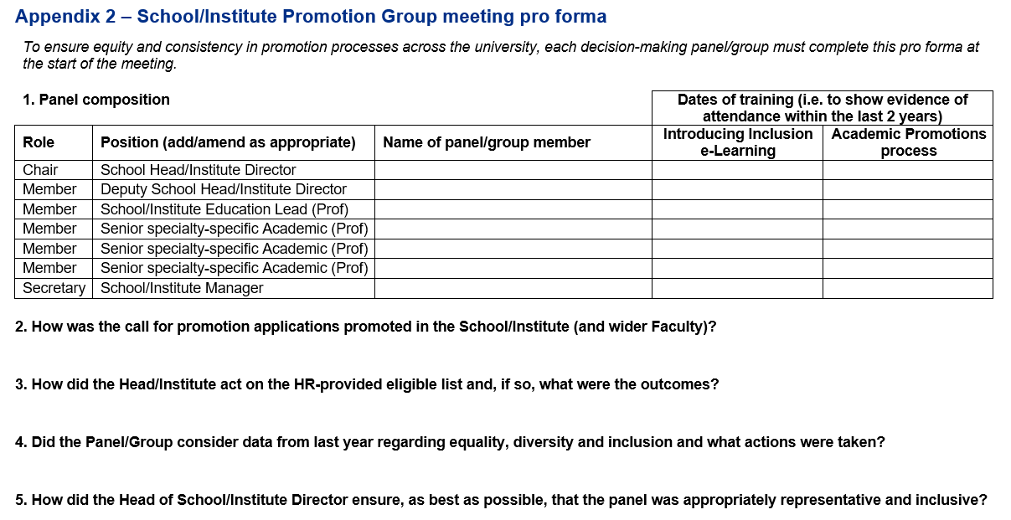
School/Institute Promotion Group Meeting Pro Forma

Slide 20
Principles of the School/Institute Promotion Group Meeting
Consider applications in order of seniority, beginning with applications for Senior Lecturer, followed by Reader and then Professor
Form an evaluation of the case with analytical and purely factual input, together with clear evidence to support statements under each section
In rare circumstances, the Head/Director can seek further information from the applicant or other staff relevant to the application
  Where this is required and additional information is provided, the Head/Director should seek comment/views from fellow Group members prior to completion of the final statement.

Slide 21
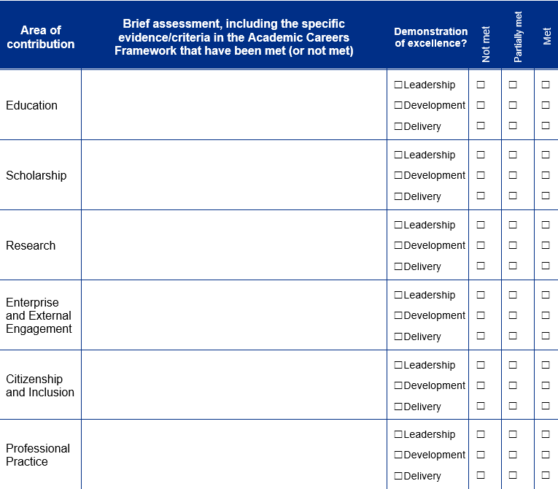
Assessment of Application (Head/Director Statement)
From the group discussions, the Head/Director should formulate a statement that explains the decision. It is shared with the Group prior to the submission to enable collective agreement.
This statement should make references to where the applicant has met (or not met) the standards of excellence in the Academic Careers Framework.
A copy of the final statement, agreed by the Group, will be provided to the applicant by HR, to allow those who wish to respond to comments (via Applicant Response) before the Faculty Panel.
Notes:
Principles – Accurate, Fair, Honest, Aligned with what will be presented at Faculty Panel.
Be prepared to provide honest and constructive feedback to those not being supported for promotion – with reasoning based on evidence. Identify areas to work on before the next promotion application.

Slide 22
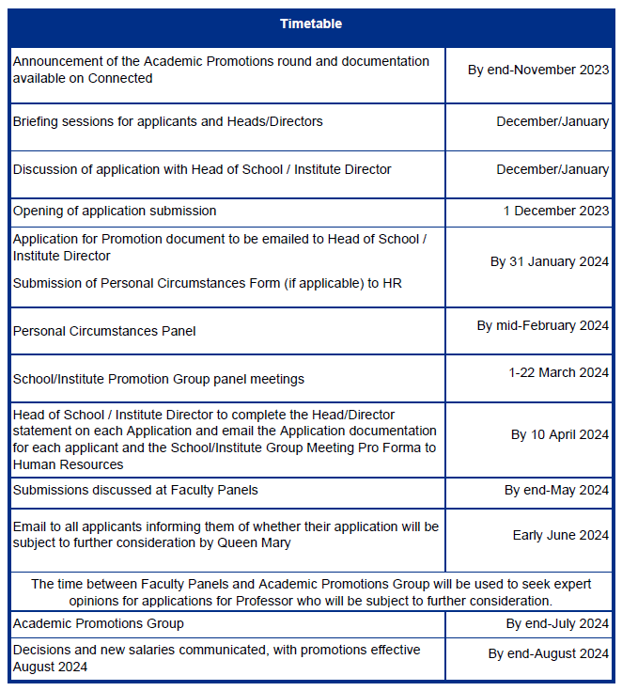

Slide 23
Further Information
Guidelines and application form are at: http://hr.qmul.ac.uk/procedures/promotion/
Contact:
rewardandbenefits@qmul.ac.uk
Any questions?

